Slide 1

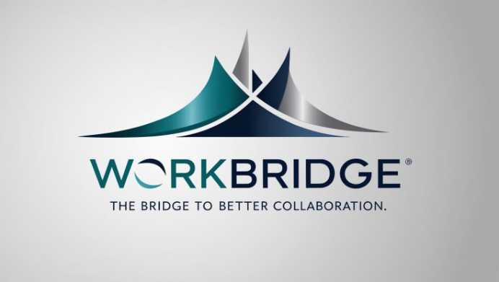
WorkBridge: Organizational Social Network
A unified workplace collaboration platform by Maor Sapo, Roy Har Zion, and Shai Yona.
WorkBridge simplifies communication and builds stronger communities.

Slide 2

What is WorkBridge?
Centralized Platform
WorkBridge simplifies organizational communication, collaboration, and community-building in one place.
Key Features
Organizational Feed for announcements
Private & Group Chats with history
Team Spaces for professional and social groups
Seamless Meeting Integration with Google Calendar and Zoom
It integrates existing tools, providing an intuitive, unified interface.

Slide 3



The Problem: Fragmented Communication
Scattered Tools
Consequences
WhatsApp for quick chats
Frequent platform switching
Slack or Email for teams
No single overview
Google Calendar & Zoom for meetings
Disconnected people and tasks
Google Drive for documents
Difficult onboarding
This fragmentation reduces efficiency and causes disconnect within organizations.

Slide 4
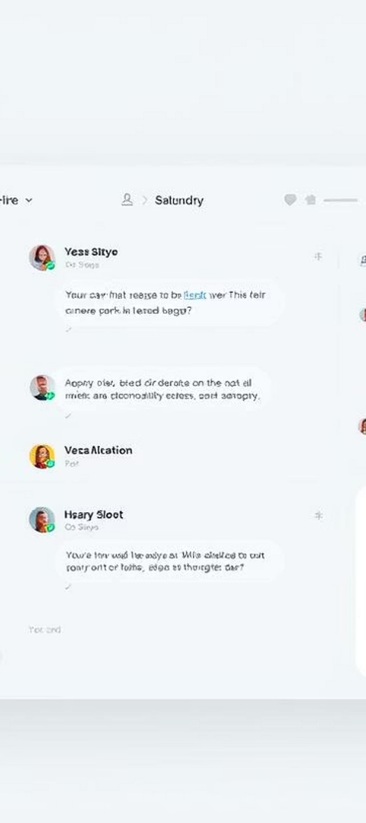




The Solution: WorkBridge Unification
Centralized Feed
Persistent Chat
See updates across teams and the whole organization.
Real-time chat with full message history.
Structured Groups
Integrated Tools
For departments, projects, or interest-based communities.
Calendar, Zoom, and shared resources all in one place.
WorkBridge delivers less distraction, better connection, and more clarity.

Slide 5
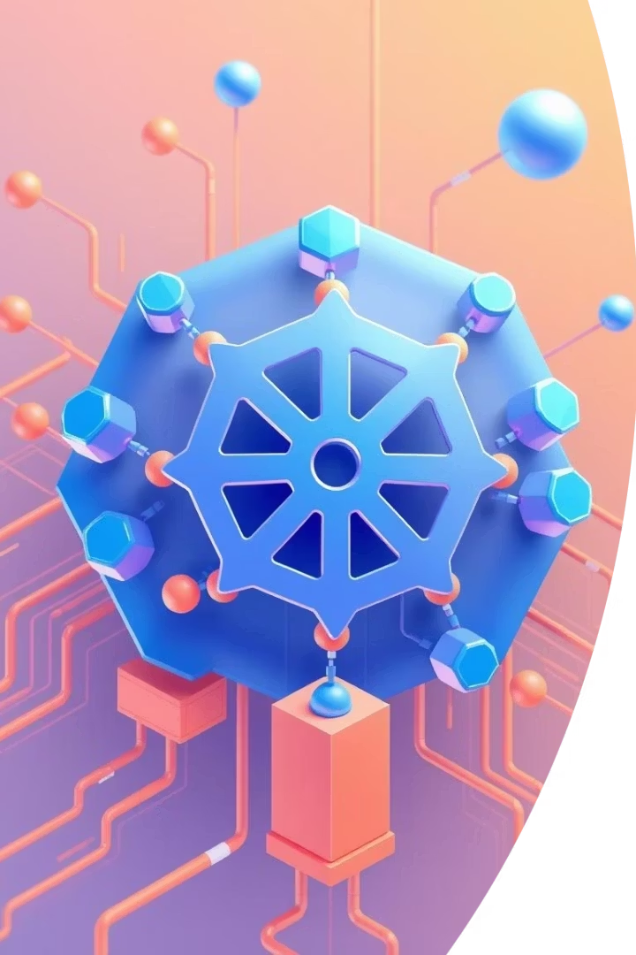




What is Kubernetes?
Scalability
High Availability
Automatic scaling as needed.
Multi-pod deployments with health checks.
Resource Management
Environment Management
Efficient allocation for optimal performance.
Secure, isolated environments.
Kubernetes is an open-source system for automating deployment, scaling, and management of containerized applications. It enhances our platform's reliability.

Slide 6
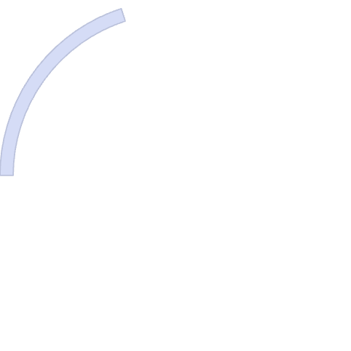

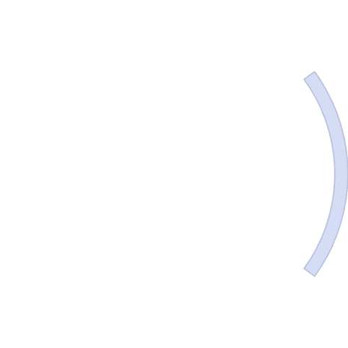

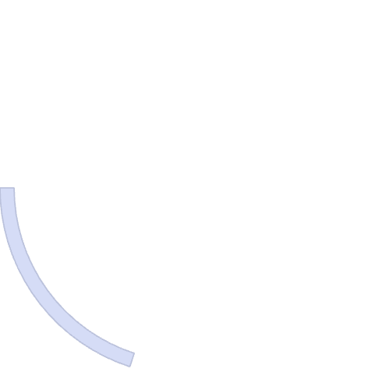





Kubernetes and WorkBridge Microservices
Chat
Authentication
Messaging functionality.
User identity and access.
Media
File sharing and uploads.
Database
Data persistence.
Frontend
User interface.
WorkBridge leverages Kubernetes to manage its modular microservices architecture. This design ensures robust performance and seamless updates.

Slide 7
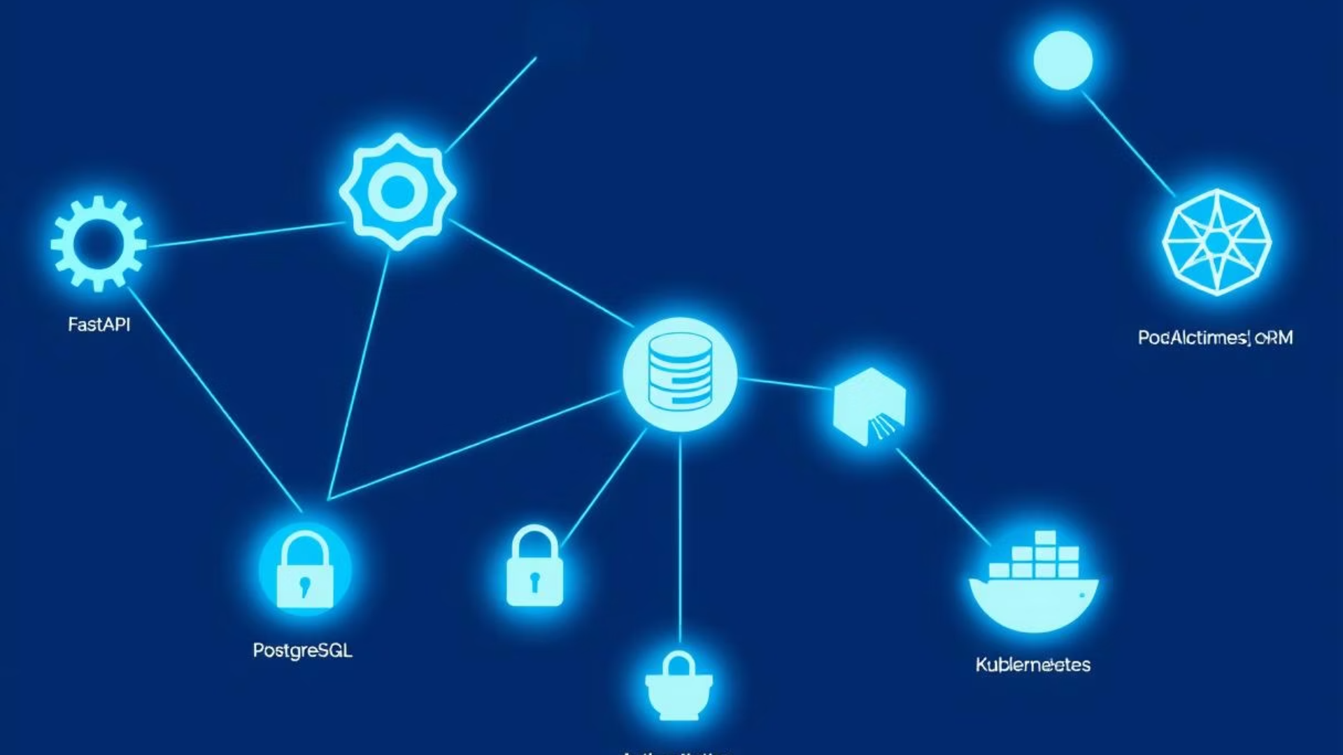




Technologies
FastAPI (Python)
PostgreSQL
SQLAlchemy ORM
JWT Authentication
Ensures speed and type safety for our API.
Provides reliable ACID transactions for data integrity.
Connects Python objects to SQL queries for development efficiency.
Offers stateless and scalable user authentication.
Docker & Kubernetes
Containerization and orchestration for robust service deployment.
Our tech stack is chosen for performance, scalability, and maintainability.

Slide 8
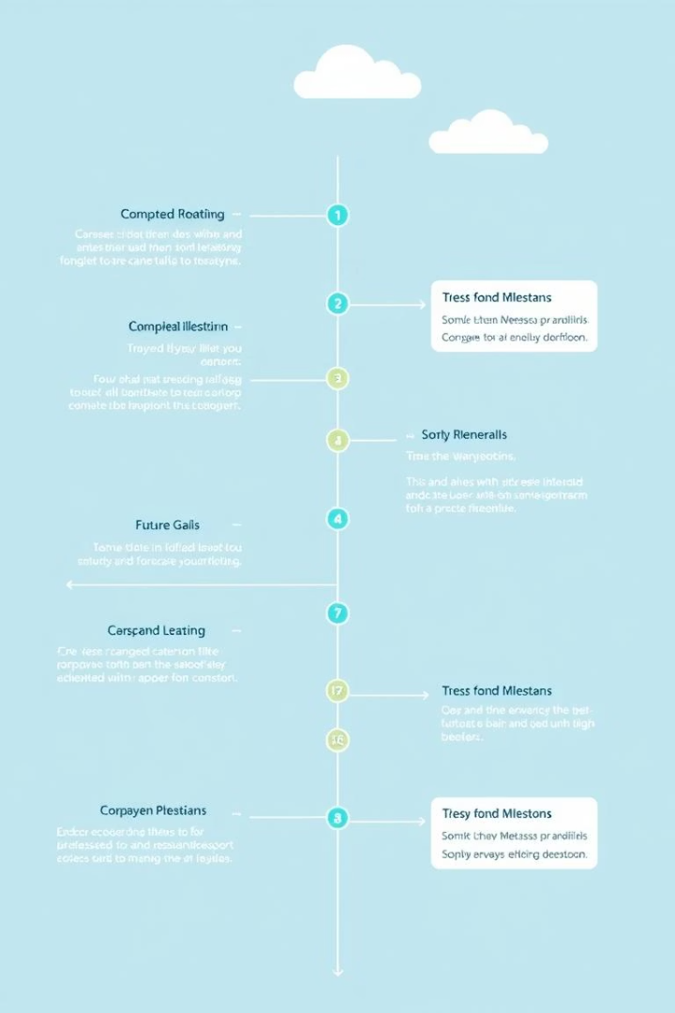
Project Status & Next Steps
1
What's Done
Auth flow end-to-end (FastAPI + React)
DB schema for users & chat
Basic React pages: login, dashboard, chat
Initial chat endpoint + UI
2
Must-Have (Before Final)
Full UI for messages & group management
Organizational Feed (backend + frontend)
Kubernetes deployment setup
Add real-time messaging support (WebSocket)
3
Nice-to-Have
File sharing per group
Offline read-only mode
We have a solid foundation and clear steps for completion and future enhancements.

Slide 9




THANK YOU
Our Vision
User Experience
Technical Foundation
Unified workplace collaboration.
Intuitive and efficient design.
Built to scale reliably.
We aim to transform workplace interaction. Questions?

